Slide 1
Primary Care Update: Wirral Practice Managers Forum
Dr Paula Cowan
MB ChB LRCSPI DFFP DRCOG MRCGP
NW Medical Director for Primary Care
28th June 2023

Slide 2
Agenda
Primary Care Access Recovery Plan
Contractual changes
Timelines
Delivery chain
Access
Workforce
Fuller
Primary Care Improvement Programme
System Working and Interface
What does the future look like?

Slide 3
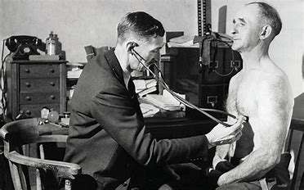
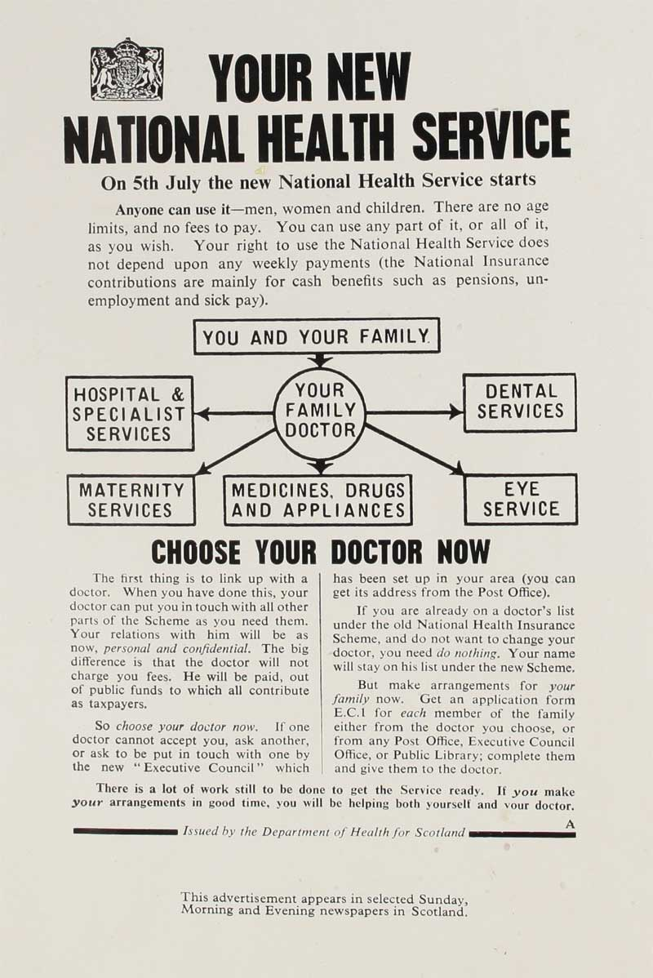
1948 Once upon a time …..

Slide 4
…….2023

Slide 5
The Delivery Plan for Recovering Access to Primary Care is one of three NHS strategic recovery plans addressing priority areas
Recovery plans
Elective recovery plan
Urgent and Emergency recovery plan
Primary Care Recovery Plan
Key ambitions:
That the waits of longer than a year for elective care are eliminated by March 2025
95% of patients needing a diagnostic test receive it within six weeks by March 2025.
75% of patients who have been urgently referred by their GP for suspected cancer are diagnosed or have cancer ruled out within 28 days by March 2024
Improve both waiting times and patients’ experience of waiting for first outpatient appointments over the next three years.
Key ambitions:
Patients being seen more quickly in emergency departments: with the ambition to improve to 76% of patients being admitted, transferred or discharged within four hours by March 2024, with further improvement in 2024/25.
Ambulances getting to patients quicker: with improved ambulance response times for Category 2 incidents to 30 minutes on average over 2023/24, with further improvement in 2024/25 towards pre-pandemic levels.
Key ambitions:
To tackle the 8am rush and reduce the number of people struggling to contact their practice. No longer will patients be asked to call back another day to book an appointment.
For patients to know on the day they contact their practice how their request will be managed.

Slide 6
Why we need a Delivery Plan for Recovering Access to Primary Care
The Autumn Statement committed the NHS to publish a recovery plan for primary care.
The plan focuses on recovering access to general practice and supports two key ambitions:
To tackle the 8am rush and reduce the number of people struggling to contact their practice. No longer will patients be asked to call back another day to book an appointment.
For patients to know on the day they contact their practice how their request will be managed.
If their need is clinically urgent it will be assessed on the same day by a telephone or face-to-face appointment. If the patient contacts their practice in the afternoon they may be assessed on the next day, where clinically appropriate.
If their need is not urgent, but it needs a telephone or face-to-face appointment, this will be scheduled within two weeks.
Where appropriate, patients will be signposted to self-care or other local services (eg community pharmacy or self-referral services).
NHS England engaged with a wide range of stakeholders to develop and refine the plan, including patient and professional representative groups as well as used the insight gathered from Dr Fuller’s stocktake. It also includes key themes to be engaged on during 2023/24, including the GP contract and Pharmacy First, to support delivery of the longer term vision.

Slide 7
Governance and support workstreams are designed to support the key focus areas of the plan:
Areas to support recovery and deliver the ambitions.
 |  | Empower patients | Improving NHS App functionality | Increasing self-referral pathways | Expanding community pharmacy
 |  | Implement new Modern General Practice Access approach | Roll-out of digital telephony | Easier digital access to help tackle 8am rush | Care navigation and continuity | Rapid assessment and response
 |  | Build capacity | Growing multi-disciplinary teams | More new doctors | Retention and return of experienced GPs | Priority of primary care in new housing developments
 |  | Cut bureaucracy | Improving the primary-secondary care interface | Building on the ‘Bureaucracy Busting Concordat’ | Reducing IIF indicators and freeing up resources
1
2
3
4

Slide 8
Changes to the GP Contract in 2023/ 24
Overview
The focus for contractual arrangements for 23/ 24 is on supporting teams and improving patient access and experience. No additional requirements have been added to the PCN service specifications for 23/ 24 in recognition of current workload pressures.
This is the last year of the 5 year GP contract reform framework, which was introduced to deliver the commitments set out in the NHS Long Term Plan. NHS England will be engaging with the profession, patients, ICS colleagues, government and other key stakeholders during 23/ 24 to inform the next steps for general practice.
Key changes for 2023/ 24
Improving patient experience and satisfaction of access
Building on the success of the Additional Roles Reimbursement Scheme (ARRS) and expanding flexibility of the scheme
Changes to childhood immunisations – schedule, payments and indicators
Streamlined approach to the Impact and Investment Fund (IIF) and Quality and Outcomes Framework with a focus on staff wellbeing in the Quality Improvement module
Freeing up workforce capacity through reducing targets
Contract changed to reflect upcoming updates to vaccinations and immunisations

Slide 9
Key timelines in the first 6 months
May
June
July
Aug
Sept
Oct
Confirm Requested Support
(CBT, OC, transf. support, care navigator etc.,)
Practices/ PCNs
Practice/PCN recovery plan finalised
Co-develop & sign off practice/PCN Improvement plans
Practices submit pre-work
Engage with ICB on CBT baselining
Complete baseline
Consider potential needs
Engage with PCNs
Introduce plan
Locate peer ambassadors
Ask for first movers
Discuss practice needs and baseline
Prioritise those with CBT and most challenged
Comes away with baseline
Suggest support
Publish system level access improvement plan
Signed off practice/PCN recovery plans
SDF investment plans
Practice support plans
ICBs
Support practices with transformation
Deliver transformation support equivalent to intermediate to ~20 practices per year
Name ICB leads (Transf.,Telephony, Digital Pathways)
Nominate first movers
CBT
Intense support
Care navigator training
Support confirm.
CBT
Intensive support
Publication & next steps
Immediate actions & Forward roadmap (incl. info needed and when)
SDF & IIF guidance
Webinars for ICSs
Launch National Improvement Programme
Universal support webinars
1st Cohort of intensive support launched
Name regional and system peer ambassadors
Update & Release Digital pathway framework
Inc. online consultation, messaging and booking tools
NHSE

Slide 10
Proposed Delivery Chain for PCARP
National accountability, monitoring, governance and delivery assurance to NHSE Board, DHSC, Ministers and No10
National enablers and infrastructure, including funding, procurement and national GP Improvement Programme
Deliver national implementation plans
Set and agree targets and timetable for implementation with regions and monitor achievement, performance manage through regions if required
Facilitate shared learning and peer support at a national level and national training, resources and development
National Delivery Unit
National Workstreams
Weekly meetings with regions
National
Regions
Establish PCARP governance and working arrangements with ICBs and National Delivery Unit
Ensure each ICB has a robust plan in place with ICB leadership and ownership, and monitor delivery
Take action to ensure delivery is on track and on target, escalating to national team if required
Facilitate shared learning and peer support at a regional level
Implement national GP Improvement Programme and lead workforce development
Attend national weekly
check in
Regional governance
ICBs
Develop and implement a delivery plan with targets/trajectories, and monitor delivery across the ICB, ensuring things are “done once” where possible, and best use of funding
Deliver improvements, training and support as required, focusing on areas with less well developed primary care
Facilitate shared learning across the ICB
Participate in the national GP Improvement Programme
Feed into regional governance
ICB governance
Develop, agree, deliver and track plans at practice and community pharmacy level, escalating to ICBs where support required
Support implementation of plans within practices and community pharmacies, identify practice tiers and tailor/ provide/secure support where needed
“Do things once” at place level where appropriate
Take part in National GP Improvement Programme and deliver training as required
Feed into ICB governance
Place
PCN/
Practice
Develop and deliver a practice level plan
Take part in the National GP Improvement Programme
Feed into Place/ICB governance
Community Pharmacy
Develop and deliver a Pharmacy First Plan for each Community Pharmacy
Feed into Place/ICB governance

Slide 11
PCARP Checklist (1): Summary
1st July
Final date for Financial and procurement support to any practice that indicates to its ICB that it wants to move from analogue to digital telephony
31st August
Final date for Funding of high-quality tools for online consultation, messaging, self-monitoring and appointment booking tools
23/24 and 24/25
A range of transformation support from the National General Practice Improvement Programme (NGPIP) ranging from universal, intermediate and Intensive.
Ongoing 23/24
Repurposed £246 million of IIF to support improving access and provide capacity for transformation
23/24 and 24/25
Transition cover and transformation support funding where practices/PCNs are transitioning to Modern General Practice Access Model and require additional support (eg extra practice shifts, locums, or peer support) £13.5k/practice of flexible funding
23/24 and 24/25
Care navigation training: every practice can nominate to their ICB one member of staff to undertake training
Ongoing 23/24
Increase in ARRS flexibility and ARRS numbers
Ongoing 23/24
Communication materials available for all practices to support patients to understand digital access to practice, NHS App for repeat prescriptions, multidisciplinary general practice teams and wider care available (Pharmacy & 111)
ICBs nominate practices and PCNS for Support throughout 23/24 and 24/25
Digital and transformation lead training: every PCN can nominate to their ICB one member of staff to undertake training

Slide 12
PCARP Checklist (2): Checklist of key practice/PCN actions
1st July
Confirm to ICB request to move from analogue to digital telephony
15th July
Confirm requested support offers to ICB (including care navigator / digital and transf. lead training, transformation support, capacity backfill support, online consultation tools etc
31 July
If already on digital telephony, ensure call-back functionality and queuing is enabled
31st July
Complete PCN/practice access improvement plan with committed offers practice of flexible funding
31st July
Ensure directly bookable appointments are available online following bookable online appointment guidance
31 August
Submit ARRS and workforce plan to ICB (data automatically collected via NWRS)
30 Sept
Work with ICB to select tools to procure by reviewing user experience guidance and online consultation, messaging and booking. Implement tools once acquired
31st Oct
31 Mar 24
Apply system changes or manually update patient settings to provide prospective record access to all patients
Training all practices in the PCN to understand and use local DoS including self-referral, community pharmacy and other services
Make improvements identified in practice/PCN access improvement plan (related to actions 6,7, 8, and 9) and report to ICBs
Sign self-certification of accurate recording of all appointments and compliance with GPAD guidance
Ongoing
Ongoing
Ongoing
Ongoing
Ongoing
Offer secure NHS App Messaging to patients where practices have the tech to do so
Encourage patients to order repeat medications via app supported by comms toolkit
Use messaging software to support patients to communicate with practice including for self monitoring
Use website guidance to update and ensure improved user experience with online tools correctly displayed
Review and take up local offers for retention, see SDF guidance being published soon
Ongoing
Opportunity to feed back to ICB on progress against primary and secondary care interface difficulties
31 Mar 24
Complete prework for IIF CAIP baselining and recovery planning – Submit agreed completed paperwork to ICB for sign off
30th June
31 Mar 24
Key
4 Areas of Support
Modern General Practice Access
Empowering Patients
Capacity
Reducing Bureaucracy

Slide 13
PCARP Checklist (3): Checklist of key ICB Actions
Report progress into public Oct/Nov 2023 board and public Apr/May 2024 board
1st July
15th July
Agree with practice/PCN support needs (digital telephony, online tools training, capacity backfill, intensive support etc
31 Mar 24
31st July
31st July
31 August
30 Sept
Oct/Nov Board
Establish all self-referral pathways (including MSK, audiology and podiatry) as set out in 2023/24 guidance, also ensure pathways are in place between community optometrists and ophthalmologists
Report in public board updates and plans for improving the primary–secondary care interface (four focus areas highlighted in the recovery plan)s
Assess improvement and pay 30% CAP IIF funding at the end of year using progress against baseline and access improvement plans To be paid by 31 August 2024
Ongoing
Ongoing
Ongoing
Ongoing
Ongoing
Set up process for practices to inform of diversion to 111 and monitor exceptional use when over capacity
Agree and distribute transition cover and transformation support funding (£13.5k / qualifying practice) to support practice teams seeking to implement Modern General Practice Access model
Co-ordinate system comms to support patient understanding of the new ways of working in general practice including digital access, multidisciplinary teams and wider care available. This messaging should include system specific services and DoS
Maintain an up-to-date DoS and deliver training to all practices/PCNs on DoS.
Support PCNs to use their full ARRS budget and report accurate complement of staff using NWRS porta
Oct/Nov Board
30th June
6 August 24
Understand and sign off PCN/practice capacity and access IIF CAIP baseline using guidance and Annex B template
Sign up practices ready to move from analogue to digital telephony, and co-ordinate access to specialist procurement support through NHS England’s commercial hub. Determine whether ICB wants to follow scale approach to telephony
Co-develop and sign off PCN/practice access improvement plans leveraging example practice access improvement plans published by NHS England by 9 June
Co-ordinate nominations and allocations to care navigator training, and digital and transformation PCN leads training and leadership improvement training (50% nominations for 23/24)
Select digital tools from the Digital Pathway Framework lot on DCS product catalogue
Develop system level access improvement plans which include summary of practice/PCN improvement plans, challenges, wider support needs and barriers and ICB actions
30 May
Nominate practices and PCNs for national intensive and intermediate transformation support using the Support Level Framework. Phase A by 30 May and ongoing
Fund or provide local hands-on support to 850 practices nationally (ICBs should work with regions to determine population appropriate share of target). We would expect the level of support to be similar to the national intermediate offer, and offered alongside wider or ongoing support for practices and PCNs where required, using the outputs of the SLF
Key
5 Areas of Support
Modern General Practice Access
Empowering Patients
Capacity
Reducing Bureaucracy
Enablers

Slide 14
Delivery and implementation – role of NHS England Regional Teams:
Key asks of NHSE Regions:
Provide leadership, support and assurance on ICBs' execution of the recovery plan.
Track closely all agreed PCARP metrics/milestones and course correct, for example signups and execution of Cloud Based Telephony (CBT) transition.
Support communication & briefing of ICBs on the recovery plan & be primary question conduit for NHSE.
Support explanation of how to conduct the Support Level Framework (SLF) and other PCARP support offers.
Be able to clarify questions for expectations around spending the System Development Funding (SDF) 23/24 – opportunity for Q&As with ICBs on the recovery plan. (NB. we have already trailed similar work at NW Integrated PC Transformation Programme Board (PCTPB) for 2022/23 SDF investment in collaboration with NW ICBs).
Work with NHSE national team to rapidly design implementation approaches as the programme progresses.
Support ICBs and assure ICB plans to implement improvements to the Primary Care-Secondary Care interface.
Support ICBs with System level access improvement plans (including a summary of all the PCN/Practice recovery plans) for presentation at October/November ICB boards. (PCTPB will enable space and opportunity to share and collaborate on approaches being taken).
Regions will develop and implement an appropriate governance infrastructure to ensure smooth information and updates flow into the National PCARP Delivery Unit.

Slide 15
Delivery & implementation – NW Regional Team Commitment & Support Offers for ICBs
Principles - Ways of working – NW Region commitment to ICBs:
Implementation governance to be used/put in place with a ‘one team’ regional and ICB team(s) principle i.e. PCTPB.
We will enable collaborative discussion on variation/challenges to PCARP delivery where they occur and how collectively we can address them.
We will enable opportunity to share best practice for PCARP delivery that emerges in NW ICBs, support ways to blueprint & implement this across the Region and shape the ongoing national programme where this would benefit and contribute to the improvement of our services for patients.
Shared and supportive approach to implementation planning, oversight and delivery. As part of ongoing review, we will jointly explore flexible resourcing opportunities to further add capacity.
Regional-ICB support activities – examples of those underway and forward planned:
The NHSE NW PC Team is regularly canvassing and clarifying system PCARP queries and support requests, working closely with national
NW Region continues to support ICB queries with regards to the use and implementation of the Support Level Framework including ICB access to ‘train the trainer’ support from the NHSE improvement faculty.
NW Region continues to support and coordinate sharing of materials, updates and advice on the Practice/PCN tailored support offers including triangulation of onboarding steps and adherence to key programme milestones.
NW Region has briefed all ICBs and in process of gathering nominations of practices for NHSE discovery work on recording appointments.
NW is coordinating all CBT transactional information exchanges in support of CBT transition. This is a critical enabler to onward ICB access to NHSE financial resources in support of CBT. We are keen to maximise investment opportunity for CBT transition for the NW ICBs and PCNs.
NW will deliver and support in collaboration, bespoke targeted subject matter workshops/projects with ICB teams as required throughout the PCARP implementation journey. These will include for example: SLF and practice support offers, PCARP Digital enablers and PCARP comms collaboration, Wider PC Integration plus other topical areas of collaborative support as the programme of delivery for PCARP progresses.
NW region will provide clinical leadership support in relation to the primary/secondary care interface.

Slide 16
Improving Access: General Practice & improving experience of access
Comparison with March 2019
All North West systems are now above pre-pandemic appointment levels. The mode of appointments has changed significantly over the same period with greater telephone / digital access to complement face to face appointments
Supporting Enablers 22/23
Core Digital Offer
Practices must provide the offer and use of video and online consultations, ability to order online prescriptions and online appointment booking, two-way secure written communication, online presence such as a website, signposting (e.g. nhs.uk) via the practice’s online presence, shared record access.
On line consultation solutions offer increased choice and flexibility for patients alongside enabling the right professional to respond. To note online consultation data is not included in the published General Practice Appointments Data.
Cloud Based Telephony
An MS Teams offer to increase out-going telephone lines access to support practice teams; supporting for early transfer of practices to digital telephony solutions.
Patient Experience
Reviewing the national General Practice Patient Survey results along with local surveys and HealthWatch engagement to understand patients views of hyper-local access; to understand the use of and satisfaction with different appointment modes and referral pathways to other services such as Community Pharmacy Consultation Service

Slide 17
GP Modes of Access: Percentage of all appointment modes by year North West
All North West systems are now above pre-pandemic appointment levels and as can be observed from the Pie Charts below the number of Face to Face appointments as a percentage of all GP appointments has significantly increased in 2022 compared to 2020 and 2021.
2019 *
2020
2021
2022
*2019 data represents 10 months - March-December

Slide 18
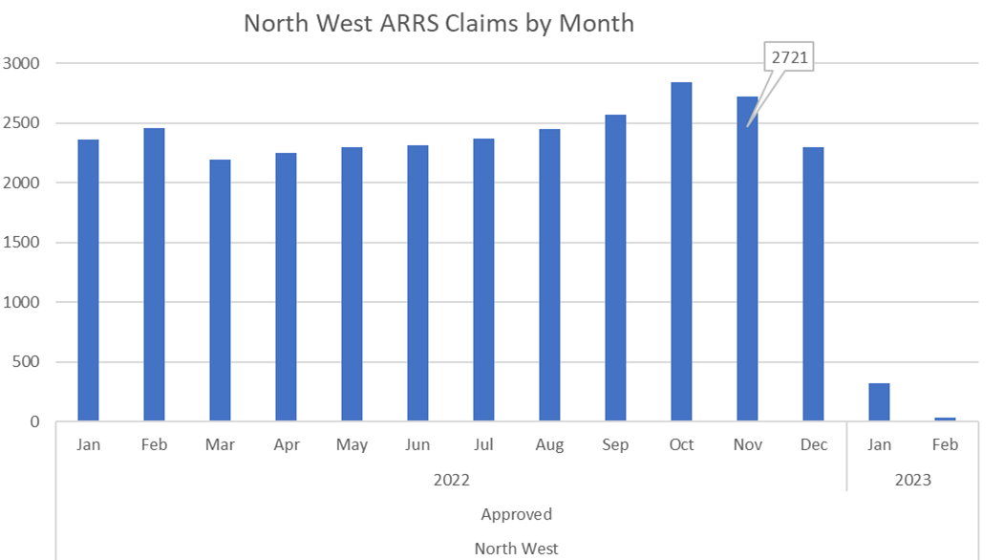
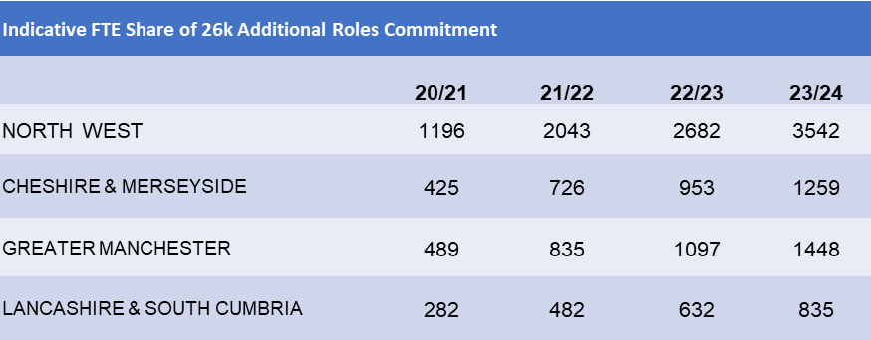
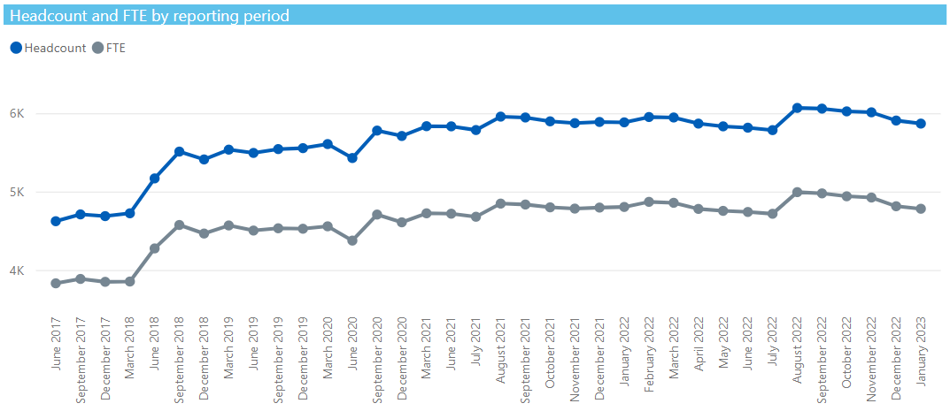
Expanding and supporting the primary care workforce
Additional Roles Reimbursement Scheme
Workforce Retention & Recruitment
GP’s
Range of support offers e.g. Mentoring, Coaching, Training & Development, Leadership, GP Fellowship scheme, GP Mentorship scheme and Recruitment support for international medical graduate doctors & employing practices
GP increases reflect the increasing GP Trainee numbers. Retaining qualifying GP a priority, supporting early career GPs with Fellowships and career support activities
Nurses
Range of support offers e.g. Preceptorship, Training & Development, Leadership, Fellowship scheme and Student placement expansion programme
ARRS
System support for recruitment of ARRS Roles including Webinars, advice, guidance and at scale advertising, Preceptorship and action learning set programmes to support new roles in Primary Care and Workforce Planning support available to all PCNs
All
Health and Welling offers including Employee Assistance Programmes for all PC staff.
Continue to promote a package of measures designed to support NHS staff to be treated with respect and kindness, including Zero Tolerance .
GP Workforce across NW Region

Slide 19
Acute Respiratory Infection (ARI) hubs
Acute Respiratory Infection (ARI) hubs and ongoing Winter pressures
Purpose
£5.244m available for NW systems to operationalise local ARI hubs providing additional capacity to support ongoing winter pressures
Priority is to support ARI community assessment, prioritising paediatric assessment and/ or for hubs already planned or established, to make funding available to increase capacity and/ or additional clinical sessions in existing hubs.
ARI hubs complement other service development programmes in place including virtual wards, same day emergency care; and unscheduled care across systems.
North West regional approach
The team has worked with colleagues from NHS @ Home and the ICBs to support implementation of the programme across the region by developing an understanding of what challenges, opportunities and learning the hubs have provided and to promote evaluative insights into sustainability of ARI and similar projects in the future. We are currently:
Evaluation - Supporting four hubs across the North West (2 in C&M and 2 in LSC) which have volunteered to participate in a national and regional community of practice for data, evaluation and sustainability in ARI hubs
Sustainability - Using information from the January and February funding generating returns to build a case for local insights, understanding and potential offsetting opportunities in hubs and primary care response to acute condition outbreaks and winter pressures
Sharing best practice, ways of working and regional analysis of the progress made in standing up these hubs in a very quick turnaround
 | Indicative Funding | Population | Number of established hubs or interventions | Total ARI assessments completed in December 2022 | Total ARI assessments completed in January 2023 | Total number of projected assessments in February 2023 | Total number of projected assessments in March 2023 | Total overall projected activity | Ave. cost per assessment
Lancashire & South Cumbria | £1,235,000 | 1,898,112 | 8 | 1,498 | 6,199 | 10,817 | 10,582 | 29,096 | £42.45
Greater Manchester | £2,146,000 | 3,300,139 | 42 | 2,111 | 9,663 | 24,329 | 29,469 | 65,572 | £32.73
Cheshire & Merseyside | £1,863,000 | 2,863,845 | 16 | 229 | 3,294 | 11,850 | 14,491 | 29,864 | £62.38
North West | £5,244,000 | 8,062,096 | 66 | 3,838 | 19,156 | 46,996 | 54,542 | 124,532 | £46.00

Slide 20
Fuller Report: Integrating Primary Care
What is the vision of the Fuller Stocktake report?
New vision for integrating primary care, improving access, experience and outcomes for our communities, centred around three essential offers:
streamlining access to care and advice
providing more proactive, personalised care
helping people to stay well for longer
The Fuller Framework and Journey to date
Includes a Framework with 15 recommendations aimed predominately at ICSs but also NHS England, DHSC and Health Education England
Builds on the transformation and development journey with the aim to evolve Primary Care Networks into Integrated Neighbourhood Teams
All three systems continue to progress with implementation of the Fuller Recommendations and have completed the national Fuller Stocktake Baseline Assessment. As part of this assessment examplar sites have been identified and shared with national colleagues to capture examples of best practice and inform policy/guidance.​
The region continues to work and link ICB and place leads with national programme colleagues to help inform key aspects of Fuller including the development of Integrated Neighbourhood Teams (LSC) and integrated commissioning (GM)​
A review of system's baseline assessment will be undertaken by regional primary care team throughout March with the aim to identify common themes, challenges and opportunities to support implementation including alignment with ICB operational plans.
The NHSE North West team continues to champion and encourage systems to utilise existing funding streams where appropriate to align with the Fuller Framework such as maximising ARRS, Clinical Leadership support, Digital First and Enhanced Access etc. Regional non recurrent funding has also been invested to address Health Inequalities through Section 7A PCN profiling and piloting initiatives such as Complete Care in the Communities.

Slide 21
Fuller Stocktake
Consensus What is not working is access and continuity, with frustrations shared by both patients and staff alike. What also emerged was a consensus on what we can do differently.
Integrated neighbourhood ‘teams of teams’ need to evolve from Primary Care Networks (PCNs), and be rooted in a sense of shared ownership for improving the health and wellbeing of the population. They should promote a culture of collaboration and pride, create the time and space within these teams to problem solve together, and build relationships and trust between primary care and other system partners and communities.
Streamlined access to urgent, same-day care and advice from an expanded multi-disciplinary team, using data and digital technology to enable patients to quickly find the right support to meet their needs
Ensuring those who would most benefit from continuity of care in general practice (such as those with long term conditions) can access more proactive, personalised support from a named clinician working as part of a team of professionals
Taking a more active role in creating healthy communities and reducing incidence of ill health by working with communities, making more effective use of data and developing closer working relationships with local authorities and the voluntary sector.
Specific, excellent examples of this are already happening in different parts of the country, led by local teams. As demonstrated by the letter of support from all 42 ICS CEOs published alongside this report, there is a consistent and unequivocal commitment to building on this wealth of good practice and backing local primary care leaders to transform care for their patients.
The formal establishment of ICSs could not be more timely, and this report clearly signals the need for primary care voice and leadership to be at the heart of local and national priorities.
Alongside a commitment to local action, this report sets out a requirement for additional support from Government and NHS England, targeted most of all at fixing workforce supply, estates and digital infrastructure. The successful implementation of the vision set out will also require a pivot to locally-led action, as described in the King’s Fund literature review ‘levers for change in primary care’ published alongside this report.

Slide 22
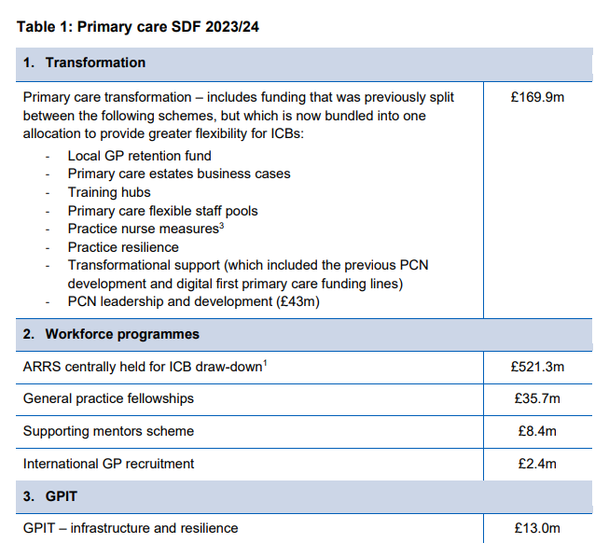
Primary care service development funding & General Practice IT funding guidance 2023/24
Primary care SDF in 2023/24 can be thought of in three sections:
A transformation budget to support change and improvement in primary care (and particularly general practice) including support to the workforce
A set of specific workforce programmes continuing from previous years (including some ARRS funding)
Funding from primary care SDF to increase general practice IT (GPIT)revenue budgets (‘GPIT Infrastructure and Resilience’).

Slide 23
General Practice Improvement Programme
Focus: supporting improvements in five priority areas:
Understanding and managing demand and capacity
Enhancing care navigation and triage processes
Improving the experience for patients of telephoning their practice (‘the telephony journey’)
Improving the experience for patients of contacting their practice and managing their care online (focusing on practice websites, online consultation tools, messaging systems and appointment booking tools)
Management of non-patient-facing practice workload.
Three levels of support.
1. Universal offer
Every practice is England can access the universal offer, which will be made up of:
webinars covering the five key priority areas and advice on how to make practical changes and improvements in general practice.
online resources on the five5 priority areas, including guidance on quick wins and best practice.
training opportunities including in quality improvement tools, techniques and leadership.
2. Intermediate offer
There are versions of the intermediate offer for practices and for PCNs.
The intermediate offer for practices is a hands-on package of support delivered over three months to enable planning and delivery of improvements. This support will include facilitated, in-person sessions, a data diagnosis and a tailored analysis of demand and capacity.
The intermediate offer for PCNs consists of 12 facilitated sessions to support the PCN to develop and agree a jointly-owned shared purpose, understand demand and capacity across the network, and identify local solutions to issues. The sessions will encourage the PCN to develop or build on its existing at-scale working, effectively utilise Additional Roles (ARRS), and to share learning across the network.
3. Intensive offer
The intensive offer provides targeted, hands-on support for those practices working in the most challenging circumstances. Delivered over six months, practices will benefit from on-site support as well as group-based sessions to facilitate peer-to-peer learning and sharing of experience across practices.

Slide 24
Optimising wider primary care including Community Pharmacy
Increase the use of Community Pharmacy in 4 specific areas:
Community Pharmacist Consultation Service GP-CPCS and NHS111
Community Pharmacy Hypertension case-finding service
Pharmacy Contraception Service.
NHS Discharge Medicines Service (DMS)
Current NW Community Pharmacist Consultation Service (CPCS) Performance:
The number of North West GP referrals to CPCS in December 2022 was 14,664 and this is significantly higher than any previous month. (November 22 = 9,836)
The number of North West referrals from NHS 111 to CPCS in December 22 was 12, 538 up 10,196 the previous month
The North West was an early adopter of CPCS and is one of the top performing regions nationally.
The North West has more referrals to CPCS per head of population than any other region
NHS Planning guidance 2023/24 and integration with wider primary care
ICB enhanced deployment for GP-CPCS.
ICB wide Minor Ailment Scheme to overlay alongside GP-CPCS.
PCN focus on GP-CPCS referrals per 1,000 population per practice.
Training and implementation support for expansion of GP-CPCS.
Blood Pressure service and direct booking for patients for checks in at pharmacies
Full roll-out of the new contraception service
Enhanced deployment of Discharge Medicines Service (DMS) to maximise hospital utilisation

Slide 25
A continued focus on Health Inequalities
Complete Care Communities Programme (CCCP) - overview
The CCCP has been designed to tackle health inequalities through the creation of local demonstrator sites known as ‘Complete Care Communities’
Establish the evidence and causation of disparities - then design new ways of providing care
The Complete Care Community Programme supports Primary Care Networks to identify and narrow health inequalities in their local area - adopt a systematic approach to addressing the wider determinants of health inequalities
12 sites part of this programme and their selected programme topics
Due to the success of this programme a further wave of sites will join the programme.

Slide 26
System working: Integrated Care Systems

Slide 29
Recommendations

Slide 30
General Practice : Current Issues
Workforce issues
Exhausted staff: Its not just about appointments. Hidden work
Are we being kind to each other
Constant request to go “back to normal”… what is normal
New normal: harnessing innovation, MDT approach
True care navigation , with more closed episodes of care
Right care, right place, right clinician
Digital Technologies and Platforms
Patient ownership, PAM
Why must General Practice always the Gatekeeper?
Support Leadership Development

Slide 31
Future of General Practice
Understanding and knowledge of the wide role of Primary Care in the 21st Century
Evolving
PCN and INT: MDT and wider workforce
“Back to Normal”.. Its 2023, not 1948
IT solutions, Digital Technology
NHS App
Patient record access
Self Care and Personalised Care
“GP is best placed”… really ??
Challenge and Change

Slide 32
Thank you

